Slide 1
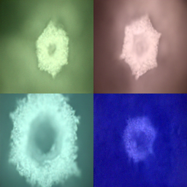
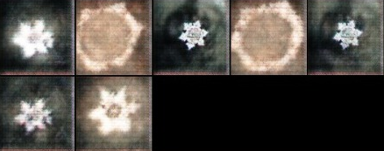
Surveying Generative Models
Farah Aymen 194233 Ashraf Adel 192680 Mohamed Negm 206069
Abstract
VAEs
Overall Comparison
Results & Conclusion
AE with regularized training to avoid overfitting and ensure that the latent space has good properties.
Types: VQ-VAE, VAE-GAN, Residual-VAE, and Multi-Stage VAE.
Model | Training Speed | FID
DCGAN StyleGAN | < ½ day > 5days | 37.11 2.42
CVAE VQ-VAE | < ½ day > 5days | 106.37 -
Denoising Diffusion | < ½ day | 3.17
Diffusion models have proved that they are state-of-the-art and overcome many of the disadvantages of the other generative models.
generative models have made remarkable progress as they are able to generate new and diverse samples which resulted in a wide range of applications such as image and video synthesis.
GANs
Diffusion Models
Composed of two networks: Generator and Discriminator.
Types: Conditional GAN, DCGAN, StyleGAN, CycleGAN, Wasserstein GAN.
Drawbacks: Mode collapse, unstable, invariant.
probabilistic generative model that breaks data by injecting noise and then learns to reverse this process.
learn the gradient of the distribution. Stochastic sampling can be used.
VAEs vs GANs
Dataset | Method | Inception Score
MNIST | VAEs | 3.32
 | GANs | 9.05
CelebA | VAEs | 2.78
 | GANs | 7.02
CIFAR-10 | VAEs | 3.0
 | GANs | 6.8
Diffusion Model
Diffusion Beat GANs
Dataset | Model | FID | Precision | Recall
AIROGS | StyleGan-3 | 20.43 | 0.43 | 0.19
AIROGS | Medfusion | 11.63 | 0.70 | 0.40
VAE-GAN

